Slide 1

SDET Project
Midterm Presentation
06/09/25

Slide 2

01
Introduction
System Demonstration
Develop & Testing (based on V-model)
Test Results Analysis
Lessons learned
02
03
04
05

Slide 3

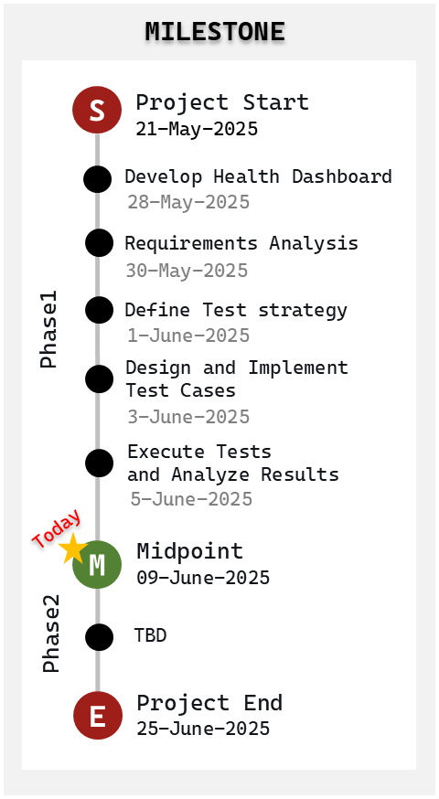
Introduction
Project Overview
Background
Client requested to add a Raspberry Pi-based Health Dashboard to the existing ADS-B-Display system.
To ensure customer satisfaction, a structured quality assurance process is required to validate the reliability and stability of the added functionality.
Quantitative Goals
Qualitative Goals
Functionality Implementation : 100%
Testing Coverage:
Blackbox Testing
requirements coverage : 100%
boundary value testing
exception case testing
Whitebox Testing
Statement Coverage: 100%
Branch Coverage: 100%
Apply V-Model with Agile elements
Design modular, testable architecture (removed legacy dependencies)
Build a testable architecture with CI/CD support
Automate static analysis and code coverage measurement
Adopt TDD practices from training
Completed Tasks
Remaining Tasks
Implemented Health Dashboard
Test Case Design and Execution based on the V-Model
Automated CI/CD Pipeline setup using Jenkins
Automated static analysis and code coverage measurement
Ensure full testing coverage
Static Analysis Issues (Low : 79)
Fully Automated CI/CD Pipeline
BigQuery Integration

Slide 4





Introduction
Team members and roles
We are SDET team 2 and the team called ‘Jet Lag’.
We've had a hard time with Jet Lag, but we're overcoming it and we will overcome it.
Project Leader
Test Designer
Minsu Kim
Jungyeol Lee
Define test strategy
Manage project timeline
CI/CD pipeline
Design test scenario
Design test case
Test Analyst
Test Engineer
Myeongsu Shin
Gyeongmi Jo
Test execution
Log and track defects
Document test results
Develop Health Dashboard
Develop Unit Test
Mentor
Bradley Schmerl

Slide 5

System Demonstration

Slide 6
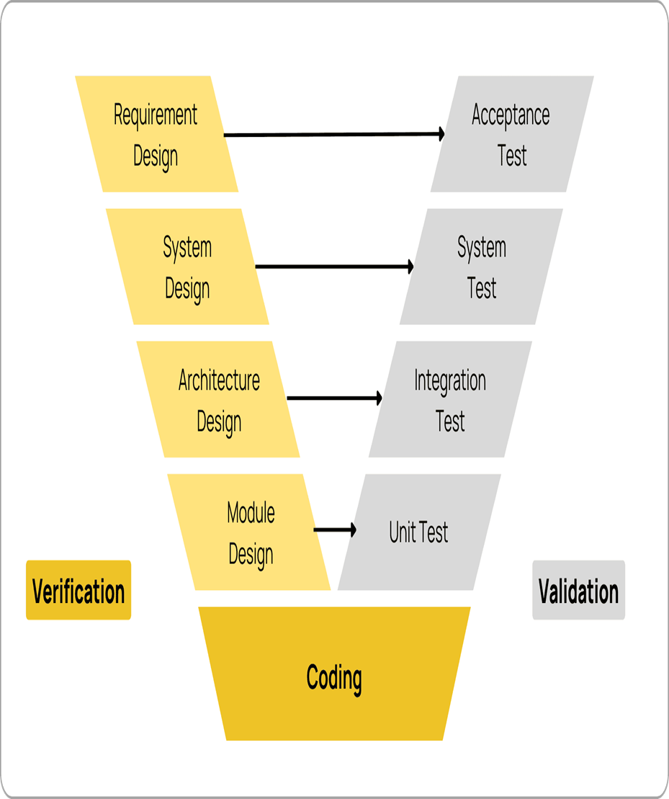
Requirement Design
1) Functional Requirement
Real-time Monitoring: CPU/Memory usage, temperature, network status
Alert System: Threshold-based warnings (CPU >80%, Memory >80%...)
Data Visualization : Progress bar
System Status: Connection status, uptime
10 requirements specified
ID | Function Description | Detailed Content
FR-01 | CPU Usage Display | Display current CPU usage (%) and maximum usage
FR-02 | Memory Usage Display | Display current memory in use (MB) and maximum memory (MB)
FR-03 | CPU Temperature Display | Display current CPU temperature (°C) and maximum temperature
FR-04 | Disk Usage Display | Display current disk usage (%) and maximum usage
FR-05 | Uptime Display | Display system uptime (DAY HH:MM:SS)
FR-06 | Data Latency | Time taken for the Display program to receive data transmitted from Raspberry Pi
FR-07 | Update Interval Setting | All information is automatically updated every 1 second
FR-08 | Menu List UI | Each item is organized in menu list format within the GUI
FR-09 | Warning Alarm Function | Display warning and timestamp when abnormal threshold values are met next to GUI items
FR-09 | Warning Alarm Function | Warning alarm criteria and display methods when system status abnormalities occur: * CPU Usage: When 80% or higher is maintained for 5 seconds / High CPU Load * Memory Usage: When 80% or higher / Memory Shortage * CPU Temperature: When 70°C or higher / High Temperature * Disk Usage: When 90% or higher / Disk Space Shortage * Data Latency: When 500ms or higher / Data Reception Delay (Timestamp not displayed separately)
FR-10 | General Error Display | Items and Display: 1. When CRC fails 3 consecutive times / Network Error 2. When initial Connect fails / Connection Failed 3. When network connection is lost / Network Disconnected

Slide 7
Requirement Design
2) Non-Functional Requirement
Performance: Real-time response within 500ms
Reliability: Stable operation during failures with user notification
Scalability : Future expansion capability for additional monitoring feature
Usability: Intuitive UI with 3-second information recognition
Maintainability : Modular structure for easy function-specific maintenance
Testability : 80% + test coverage with automated/manual verification
6 requirements specified
ID | Non-Functional Description | Detailed Content
NFR-01 | Performance | Data collection and display delay shall be within 500ms
NFR-02 | Reliability | When data transmission/reception fails, the system shall maintain previous normal values and display warning messages to users. CRC errors occurring 3 consecutive times shall be considered as 'Network Error'
NFR-03 | Scalability | Future expansion possible for GPU usage, network traffic, etc.
NFR-04 | Usability | UI shall be designed intuitively and user-friendly, and key information shall be recognizable within 3 seconds
NFR-05 | Maintainability | Modular structure for easy function-specific maintenance
NFR-06 | Testability | All functions shall be verifiable through automated or manual testing, and test coverage shall be 80% or higher

Slide 8
Acceptance Test Design
Acceptance test cases written based on functional requirements
▶ Test Cases
Test Case ID | Description | Acceptance Criteria | Test Scenario | Expected Result | Test Method
AT-01 | Display of system status monitoring UI | Key system metrics are displayed on the UI | Launch the Health Dashboard | CPU, memory, disk, temperature, uptime, etc. are displayed in real-time | Manual
AT-02 | Metric accuracy verification | Displayed metrics match actual system status | Simulate system load changes | UI metrics reflect actual system state | Manual
AT-03 | Warning on missing or faulty metrics | Notify user when metric collection fails | Simulate sensor or communication failure | UI displays “Data collection failed” or warning message | Manual
AT-04 | Performance requirement compliance | Metric update latency ≤ 500ms | Simulate continuous data collection | Latency remains within 500ms | Observation
AT-05 | UI usability | Key information is recognizable within 3 seconds | Ask user to interpret UI | User can understand system status within 3 seconds | Observation
AT-06 | System extensibility | Adding new metrics does not affect existing functionality | Add GPU usage metric | Existing features work normally, GPU metric is displayed | Manual

Slide 9
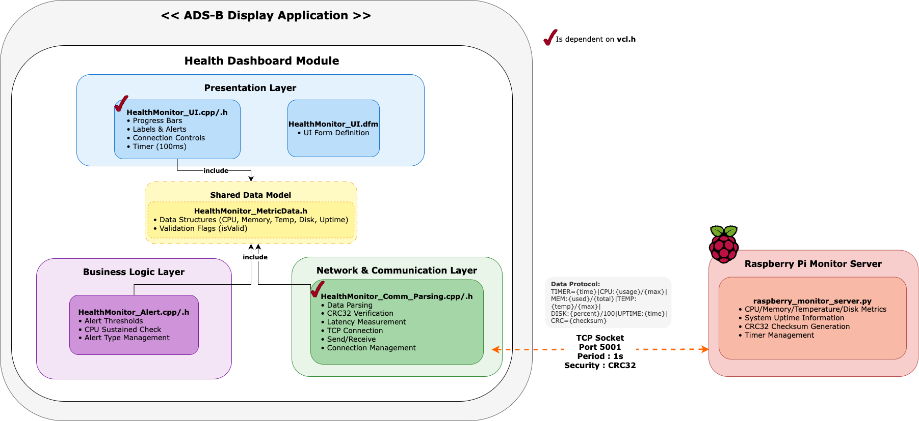
System Design & Architecture Design
System Architecture

Slide 10
System Test Design
▶ Design
Testing based on the Software Requirements Specification
▶ Test Cases
17 test cases
Test Case ID | Function ID | Function Description | Input Condition / Scenario | Expected Result
ST-01 | FR-01 | Display CPU usage | When the system is operating normally | Current and maximum CPU usage are displayed
ST-02 | FR-02 | Display memory usage | When the system is operating normally | Current and maximum memory usage are displayed
ST-03 | FR-03 | Display CPU temperature | When the system is operating normally | Current and maximum CPU temperature are displayed
ST-04 | FR-04 | Display disk usage | When the system is operating normally | Current and maximum disk usage are displayed
ST-05 | FR-05 | Display uptime | When the system has been running for a certain amount of time | Uptime is displayed in the format DAY HH:MM:SS
ST-06 | FR-06 | Display data latency | When data is being transmitted and received normally | Latency time is displayed

Slide 11
Integration Test Design
▶ Design
Integration test case design
between Parsing function, Alert function, and UI
→ Verify that warning alarms operate normally, etc.
▶ Test Cases
12 test cases(e.g., Parsing Function → Alert Function)
Test Case ID | Description | Scenario | Expected Result | How to Verify
IT-01 | CPU alert triggering | CPU usage remains at 85% for 5 seconds | Alert module returns CPU_HIGH alert | Log inspection, alert object state
IT-02 | Memory alert triggering | Memory usage exceeds 80% | Alert module returns MEMORY_INSUFFICIENT alert | Log inspection
IT-03 | Alert suppression during CRC error | CRC error state causes data parsing failure | Alert module does not trigger alerts | Log inspection, alert state check

Slide 12
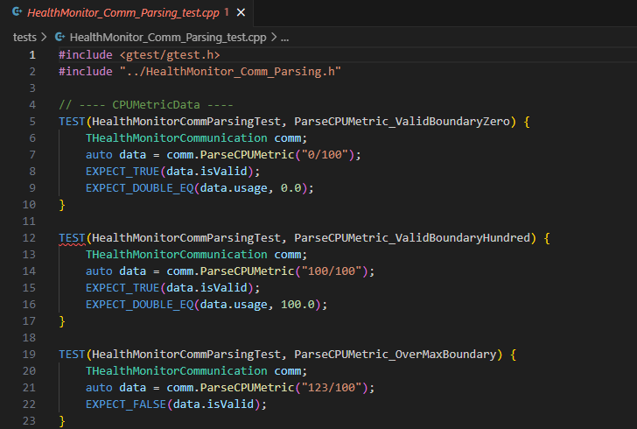
Unit Test Design
▶ Design
1) Unit Test Target Selection
Raspberry PI Data Parsing Function
(HealthMonitor_Comm_Parsing.cpp)
System Alert Function
(HealthMonitor_Alert.cpp)
2) Unit Test Method
: Google Test
▶ Test Cases
122 Test Cases(e.g., CPU Usage Parsing text using BVA)
Test Case ID | Function ID | Test Case Name | Purpose | Input | Expected Result
UT-001 | FR-09 | CPUAlert_80Degree_5Seconds_Alert | Boundary Value Analysis: Verify alarm triggers when CPU usage remains at 80% for 5 seconds | CPU 80% for 5 seconds | Alarm after 5 seconds
UT-002 | FR-09 | CPUAlert_80Degree_3Seconds_Then79_NoAlert | Boundary Value Analysis: Verify no alarm when CPU usage drops below 80% before 5 seconds | CPU 80% for 3 seconds, then 79% | No alarm
UT-003 | FR-01 | CPUAlert_MinValue_NoAlert | Boundary Value Analysis: Verify no alarm at minimum CPU usage | CPU 0% | No alarm
UT-004 | FR-09 | MemoryAlert_JustBeforeWarning | Boundary Value Analysis: Verify no alarm just below memory warning threshold | 790/1000 | No alarm

Slide 13
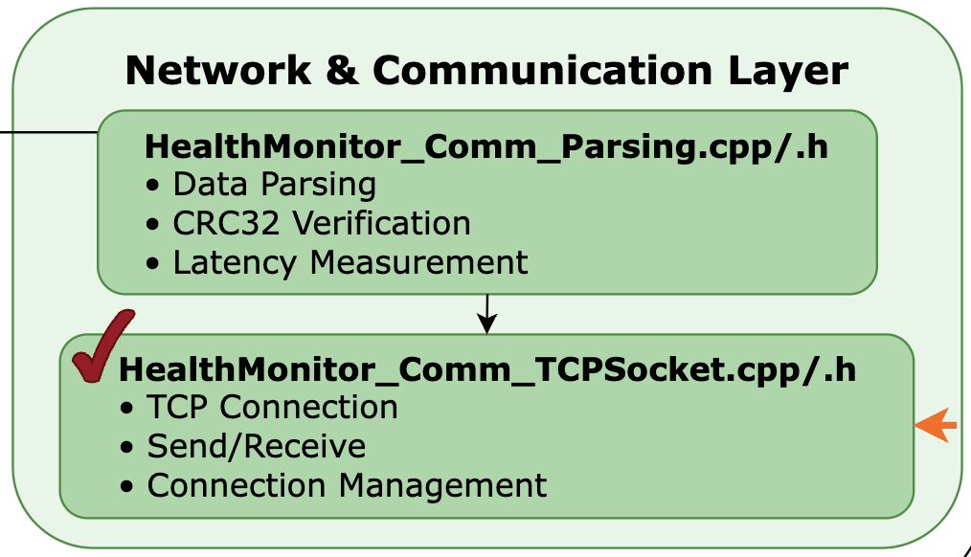
Unit Test Design
⚠️ Build Error (Unit Test)
-. Cause: <vcl.h> dependency not considered during code implementation -. Fix: Refactored code by separating files by functionality and dependency
Unit
Test!!

Slide 14











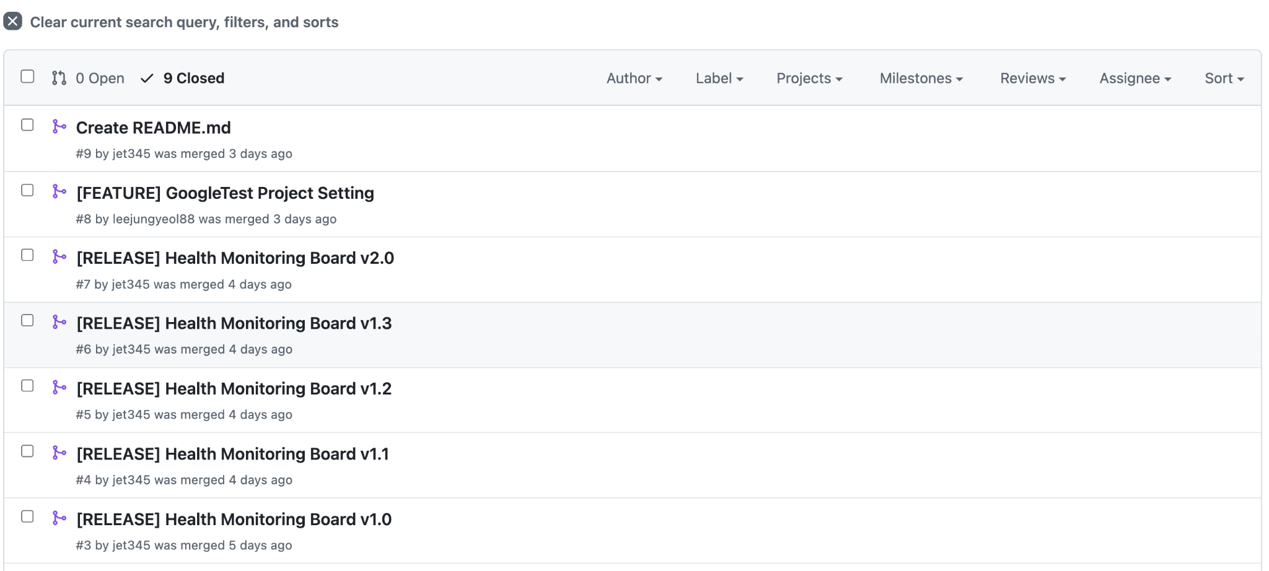
Coding
push
Google Test
Framework
+
▶ Version Control (GitHub)
https://github.com/LGSDET/SDET_JETLAG ※ private!
* Git branch strategy
├── master (default) # 🚀 Final integration & testing branch
├── gyeongmi_tcpclient # 💻 Feature development branch
├── unit_test # 🧪 Google Test environment setup
└── blackbox_test # 📋 Black-box test case development
▶ CI/CD Pipeline Setup (Jenkins)
http://172.20.1.107:8080/ ※ local server!

Slide 15
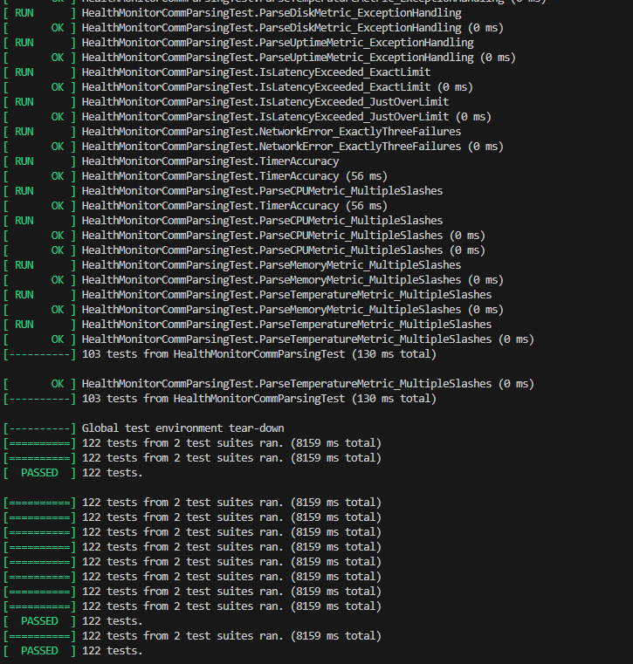
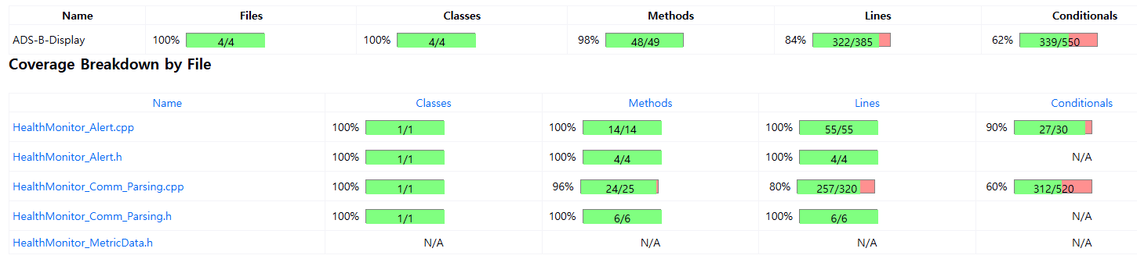
Run Unit tests
Test Design Techniques - Unit Test

Slide 16
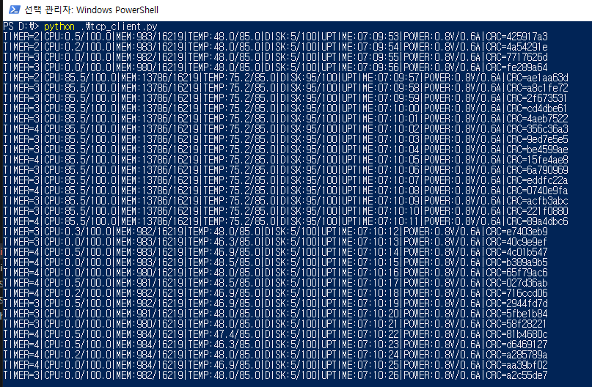
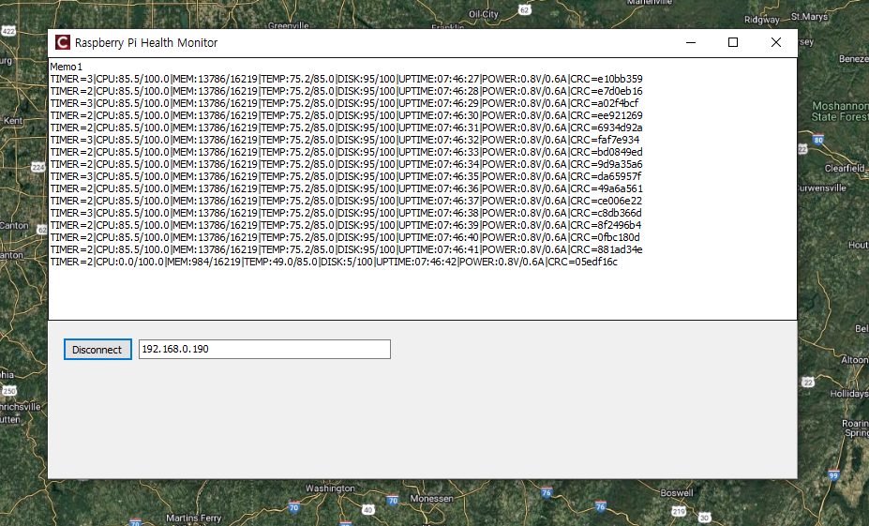
Run Integration tests
Test Design Techniques - Integration Test

Slide 17
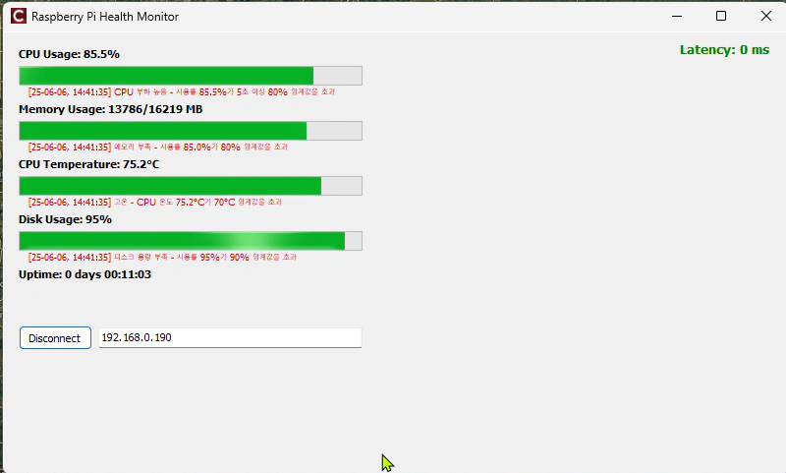
Run System tests
Test Design Techniques - System Test

Slide 18
Run System tests - Result(List of Defects)
A total of 5 bugs were identified.
※ Severity Levels
Critical: Malfunction of core functionality Major: Malfunction of secondary functionality that is noticeable by the user Minor: Noticeable by the user but occurs infrequently Comment: Not noticeable by the user
All bugs have been fixed🎉
Bug ID | Related Test Cases | Bug Description | Date Found | Severity | Verification Test
BUG-001 | ST-FR-10-04 | Health board fails after re-connection | 02-Jun | Critical | Test #2
BUG-002 | BVA-FR-02-02 TC-FR-09-02 | Memory usage warning alarm condition unmet | 04-Jun | Major | Test #3
BUG-003 | BVA-FR-03-02 TC-FR-09-03 | CPU temperature warning alarm condition unmet | 04-Jun | Major | Test #3
BUG-004 | UT-01-04 | CPU usage parsing exception not handled (negative value) | 05-Jun | Minor | Test #5
BUG-005 | UT-03-04 UT-03-05 UT-03-06 | Disk usage parsing exception not handled (negative, empty, string) | 05-Jun | Minor | Test #5

Slide 19
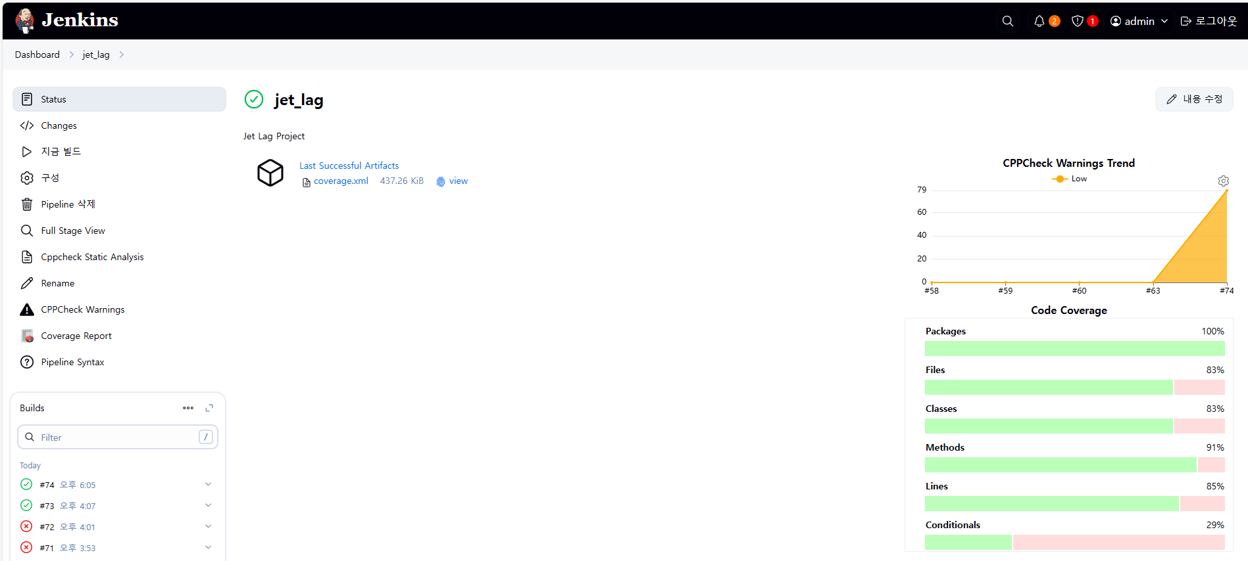
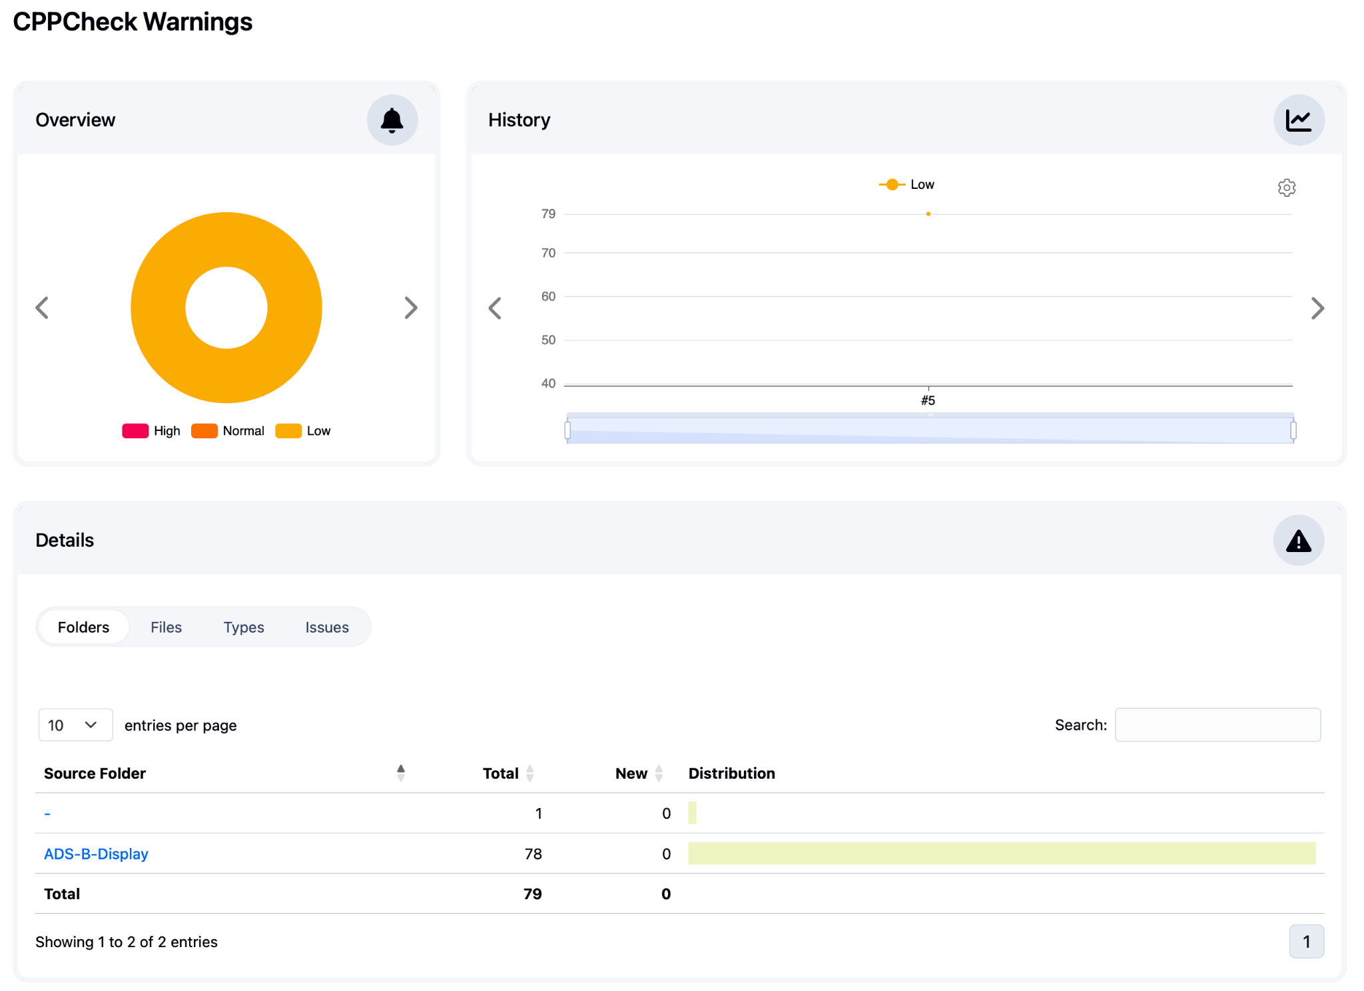
Run Static analysis
🤫

Slide 20
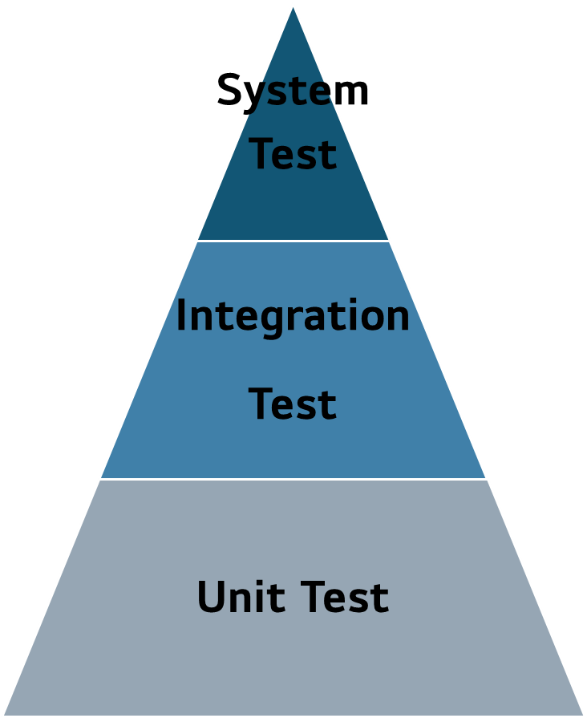
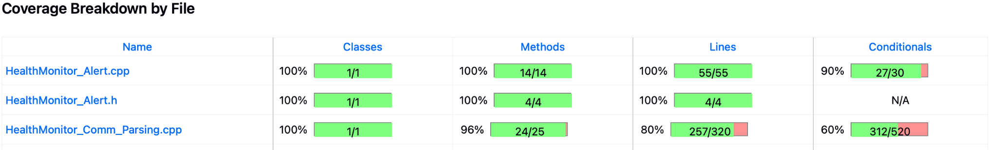
Test Results Analysis
A total of 5 tests were executed.
-. Unit and regression tests were consistently performed.
9% (15/160)
15% (23/160)
76% (122/160)
Test Period | Target Version | Tester | Test Objective | Test Type | Total | Passed | Failed | Blocked
06-02 | v1.0 | Myeongsu Shin | -. Verify core functionalities (health monitoring) -. Unit Test | Functional | 36 | 23 | 1 | 12
06-03 ~ 06/04 | v1.1 | Myeongsu Shin | -. Verification of unimplemented requirements (Alert functions) -. Unit Test -. Confirmation of defect improvement -. Regression Test | Functional | 75 | 61 | 4 | 10
06/04 – 06/05 | v1.2 | Myeongsu Shin | -. Verification of unimplemented requirements (Data latency,CRC) -. Unit Test -. Confirmation of defect improvement -. Regression Test | Functional | 110 | 110 | - | -
06/05 | v1.3 | Myeongsu Shin | -. Unit Test -. Regression Test | Functional | 130 | 126 | 4 | -
06/05 | v2.0 | Myeongsu Shin | -. Unit Test -. Regression Test | Functional | 160 | 160 | - | -
🚀

Slide 21
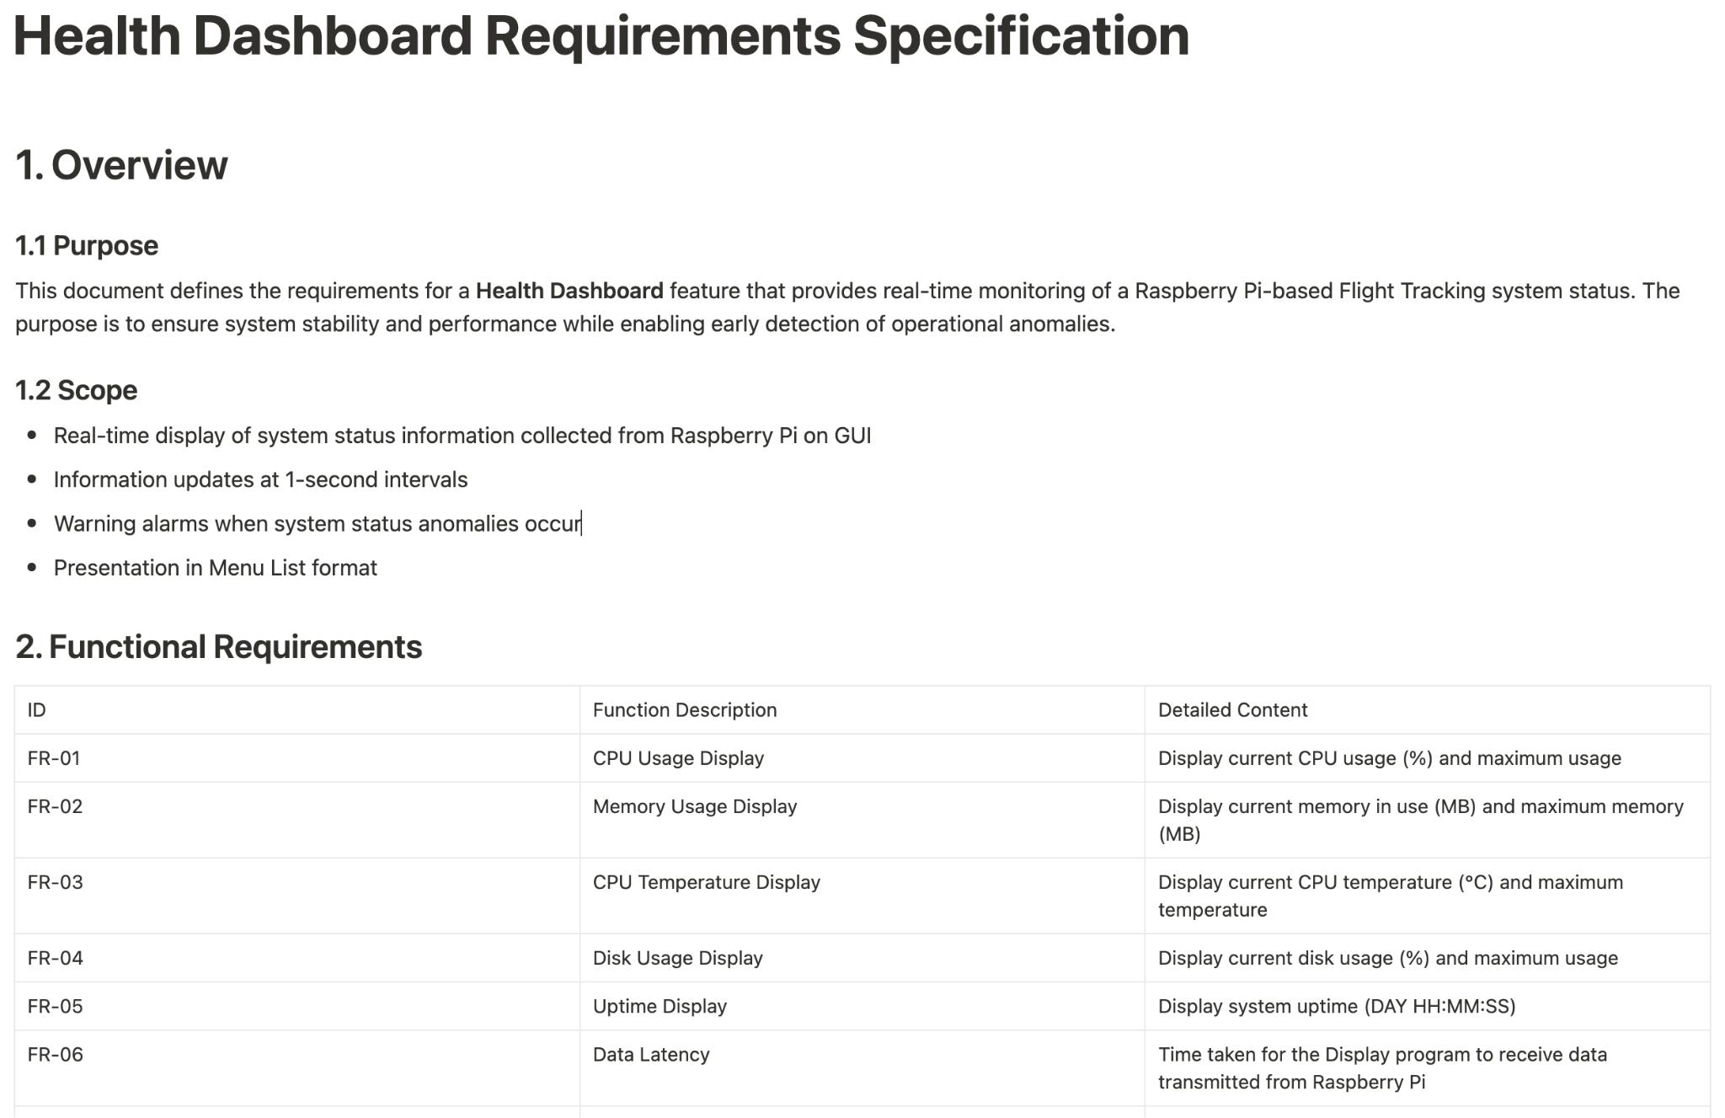
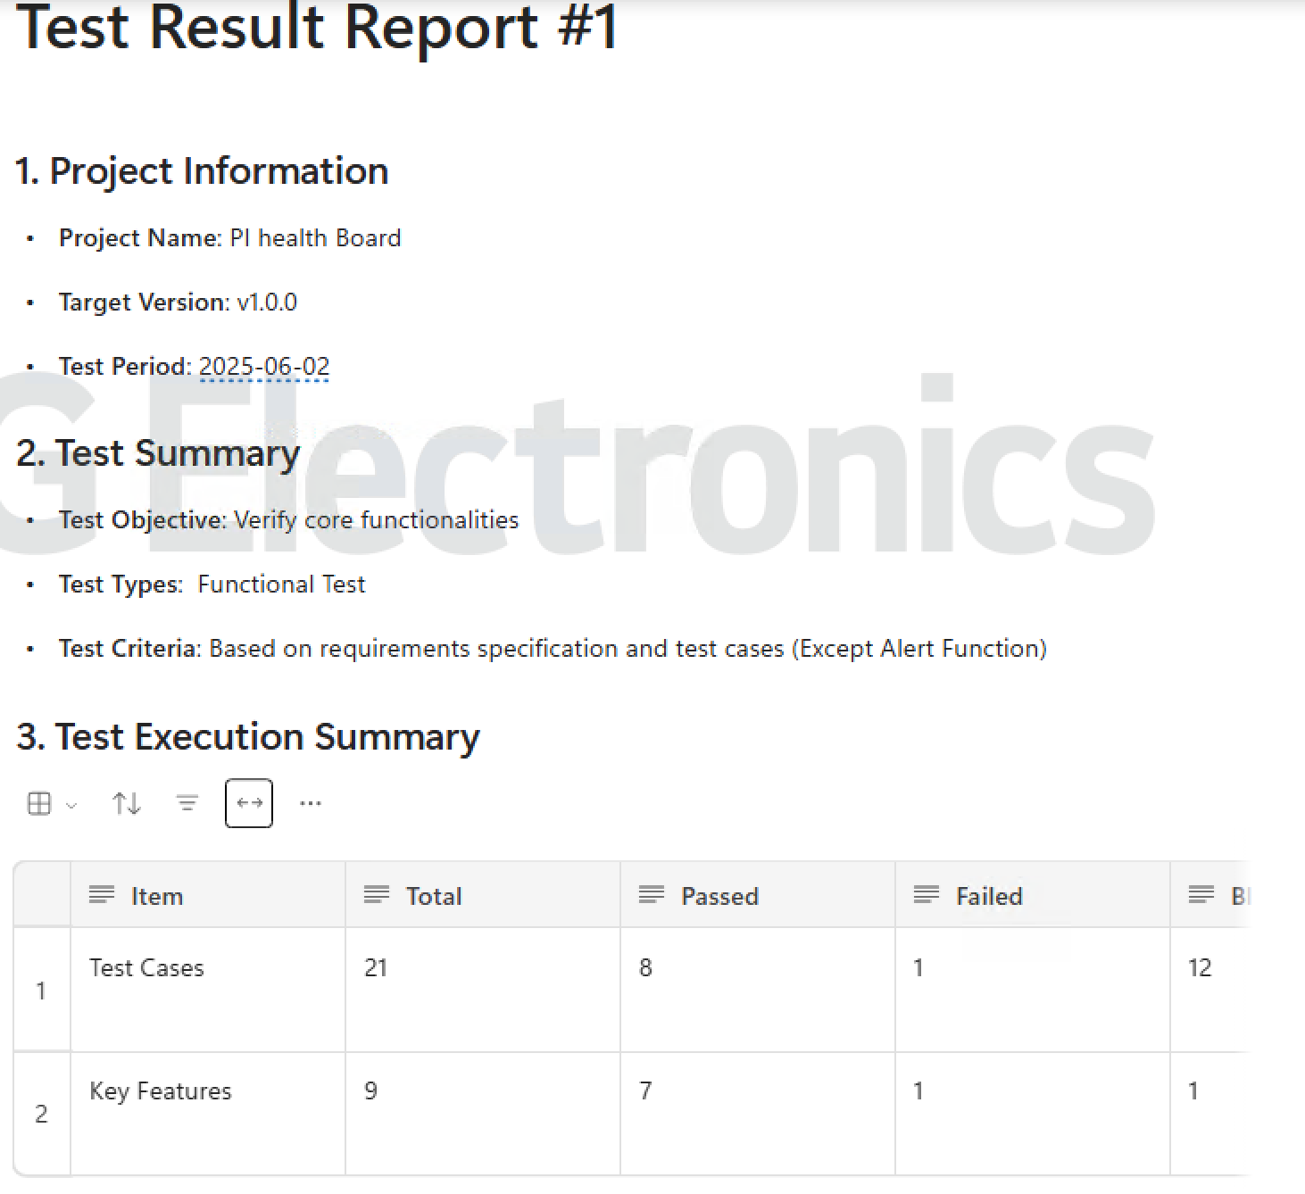
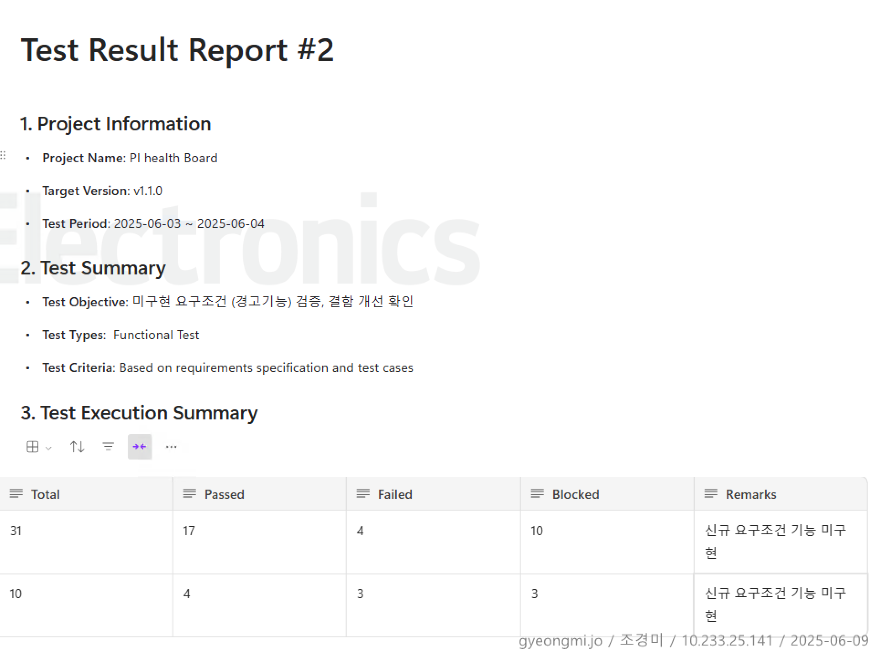
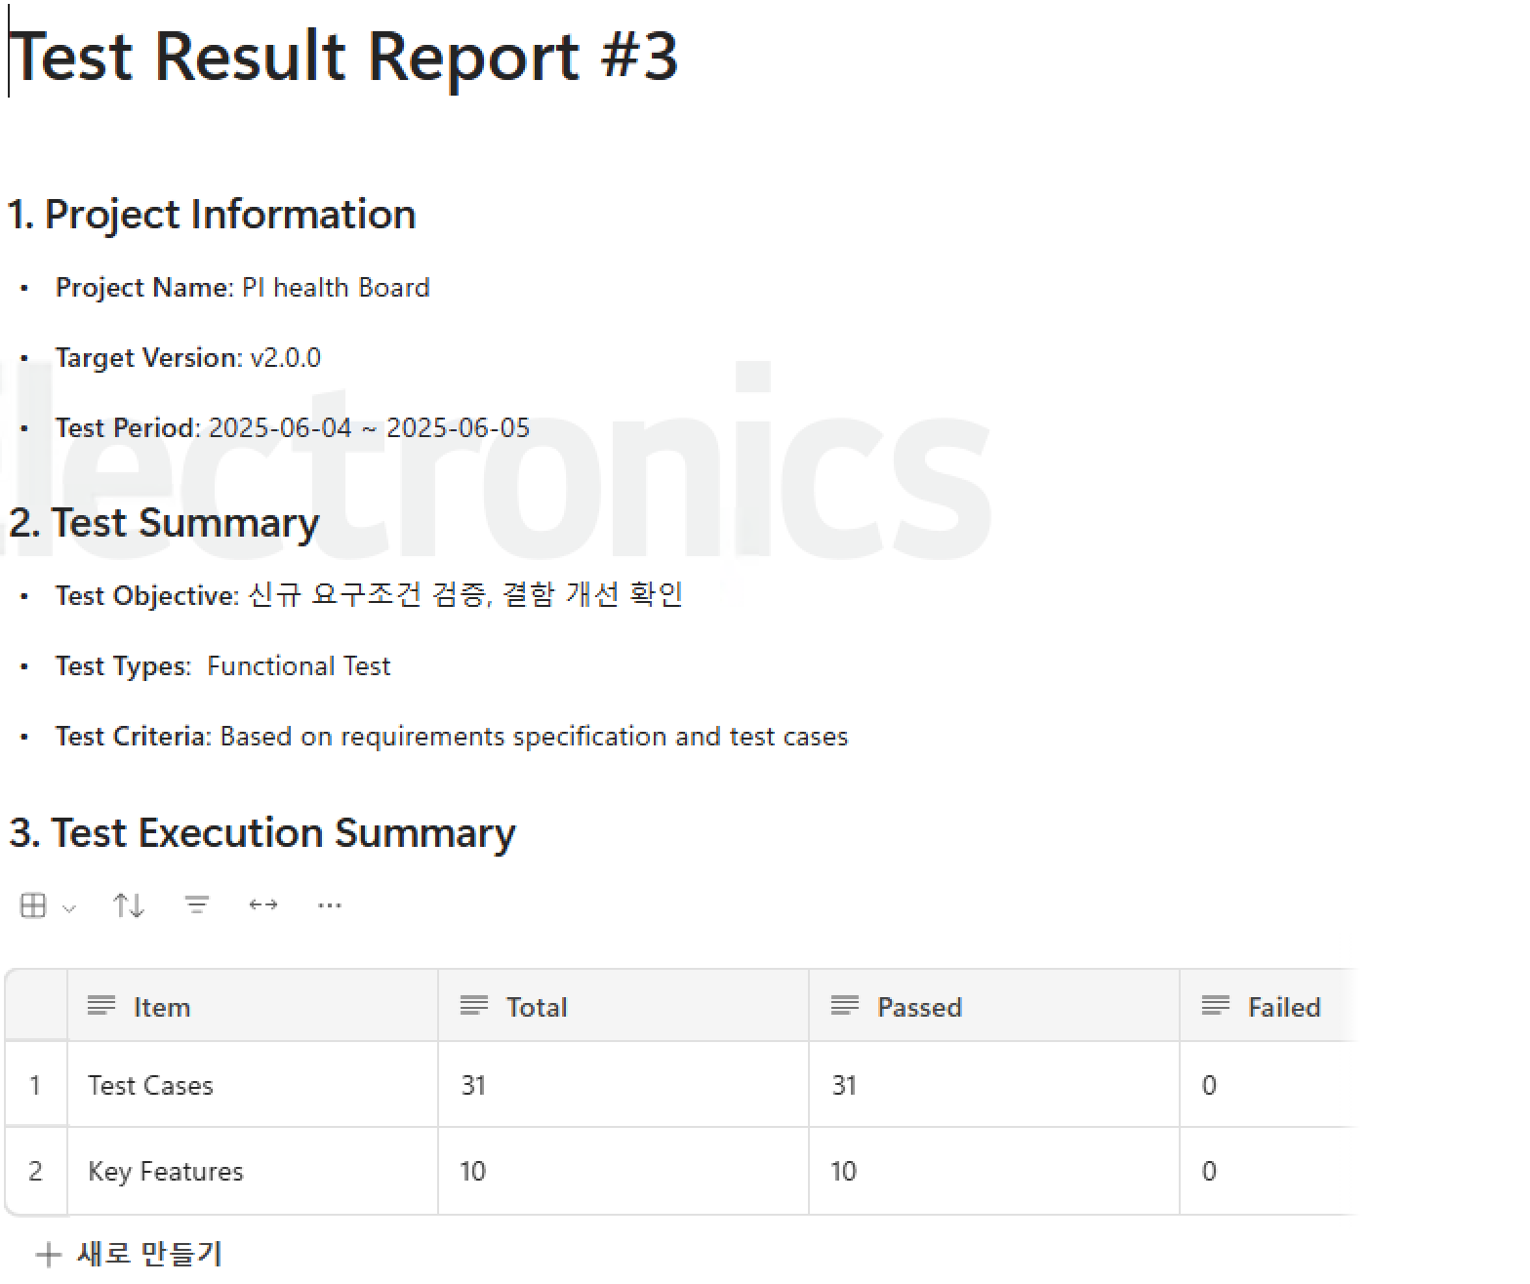
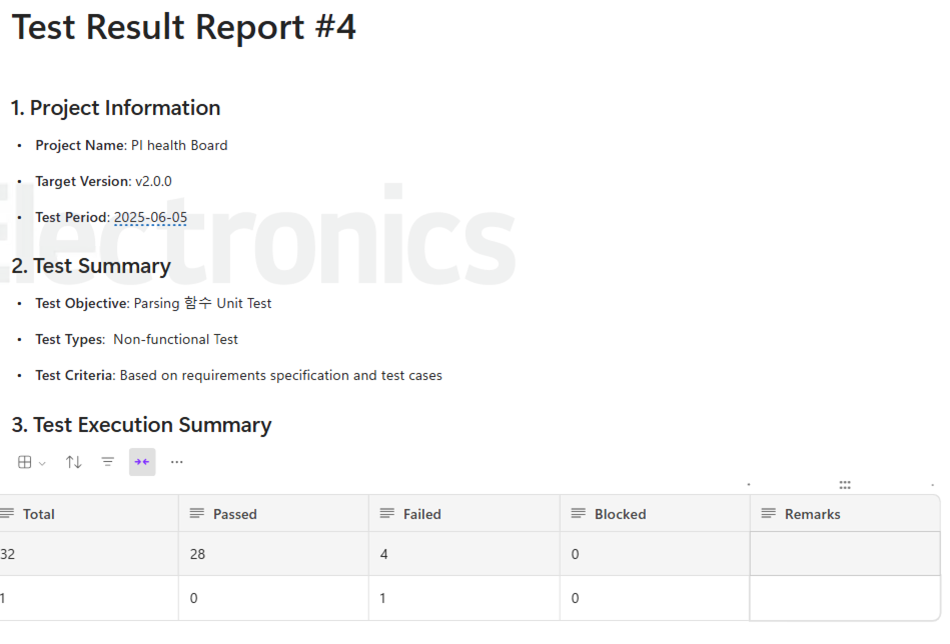
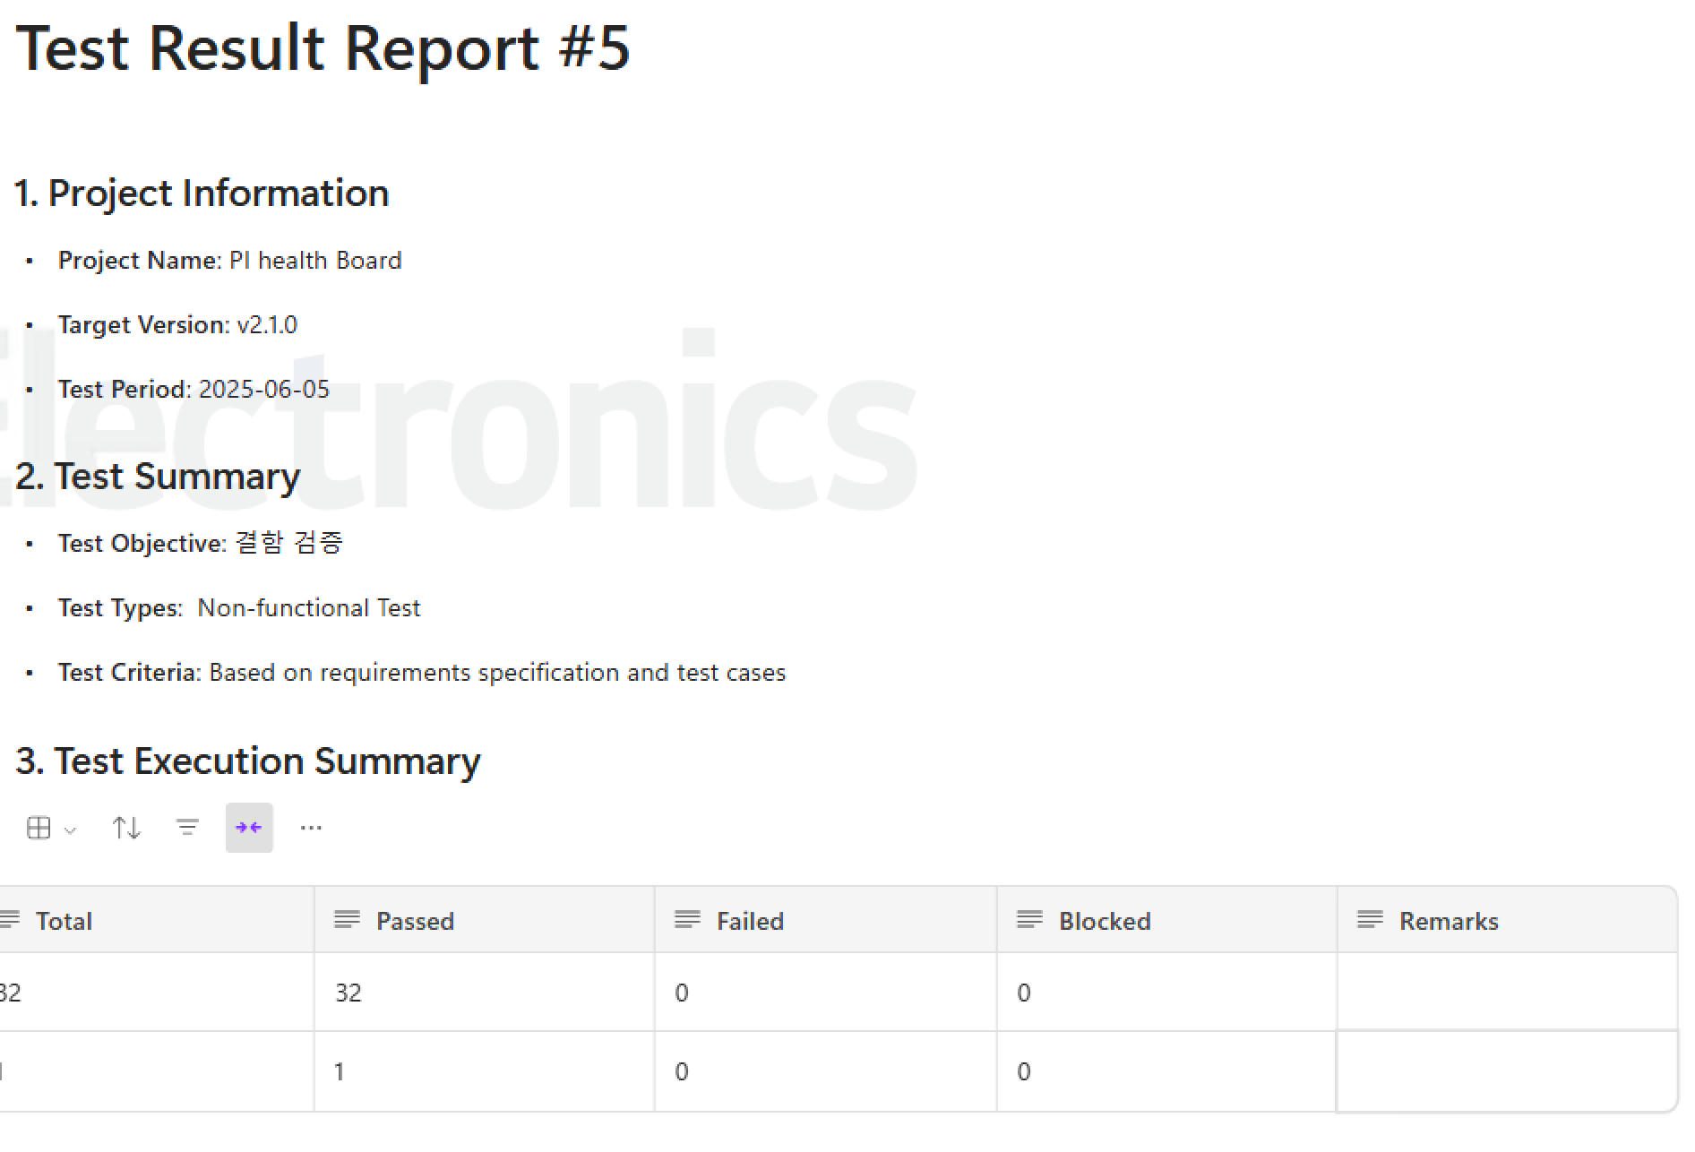
Documentation
SRS https://github.com/LGSDET/SDET_JETLAG/blob/master/Health%20Dashboard%20Requirements%20Specification%20(English).pdf
Test Report
Appendix

Slide 22
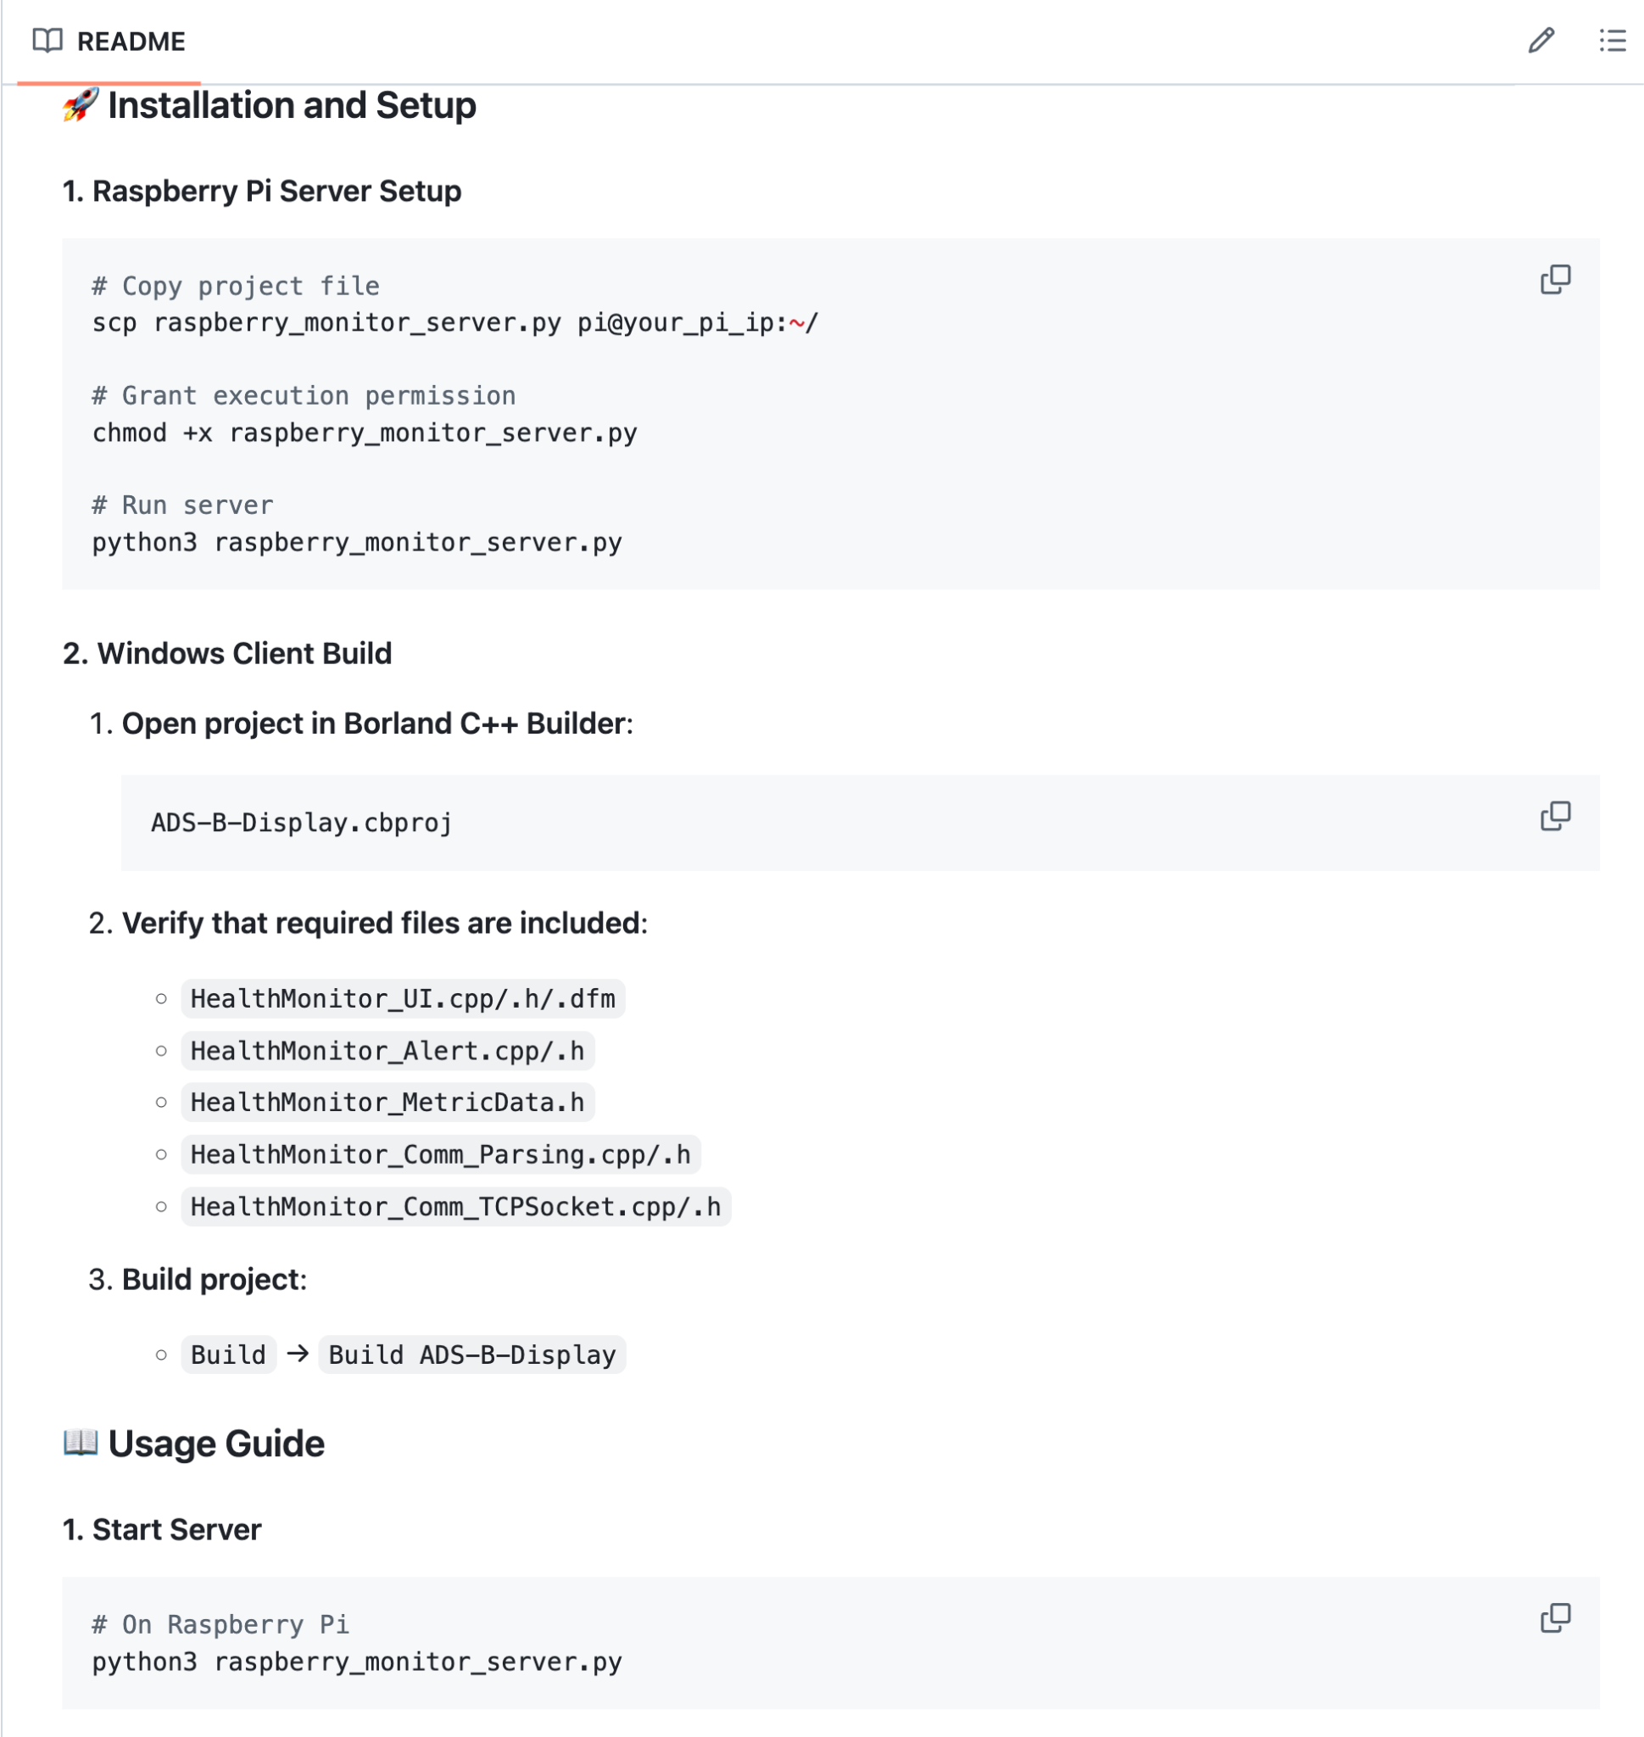
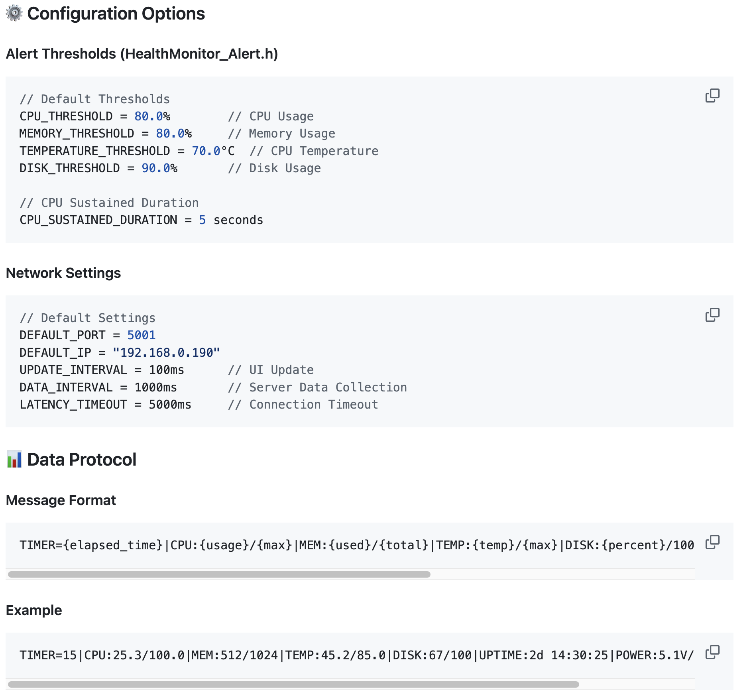
Documentation
Read.me
https://github.com/LGSDET/SDET_JETLAG/tree/master?tab=readme-ov-file#english

Slide 23
Lesson Learned
🤯Challenges
🎓Insights
🛠️ Environment SetUp 🍓 Raspberry Pi 💻 Language
🌐 Network SetUp 🛡️ Secure
📋 Testing Strategy TDD, Test Case Design
📊 Test Method Unit test, Coverage
🤖 CI/CD Environment Jenkins, Cppcheck, GTest
🛠️Application in LG
🧩 Legacy Code
⏳ Limited development time
-> But, This project will help us gradually overcome limitations.

Slide 24
Questions?
If you have any questions,
please feel free to contact us by email. 😉
(mdbzest@gmail.com)

Slide 25
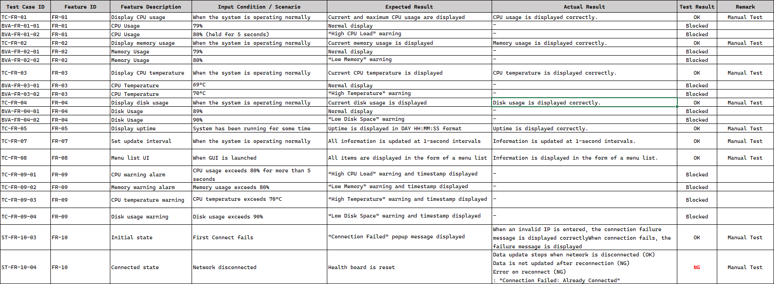
Appendix.Test #1 Result

Slide 26
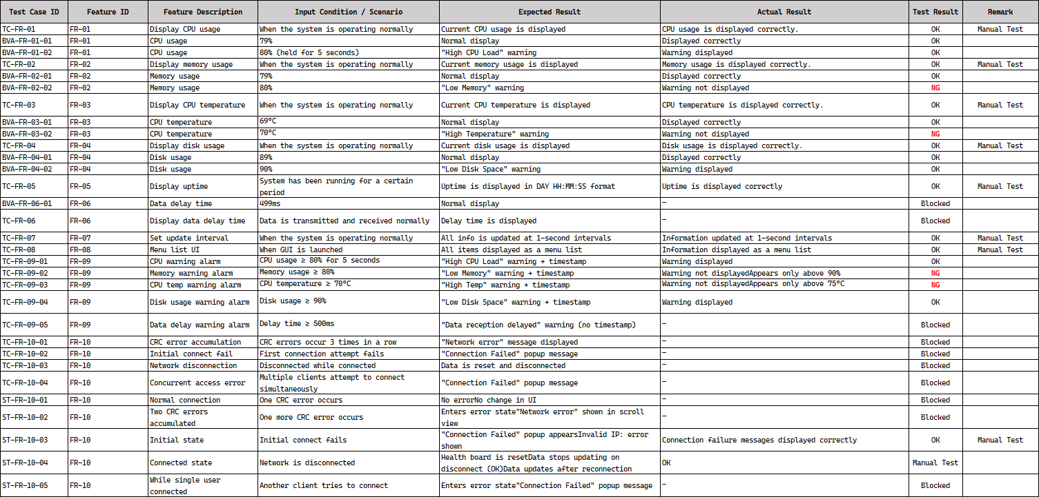
Appendix.Test #2 Result

Slide 27
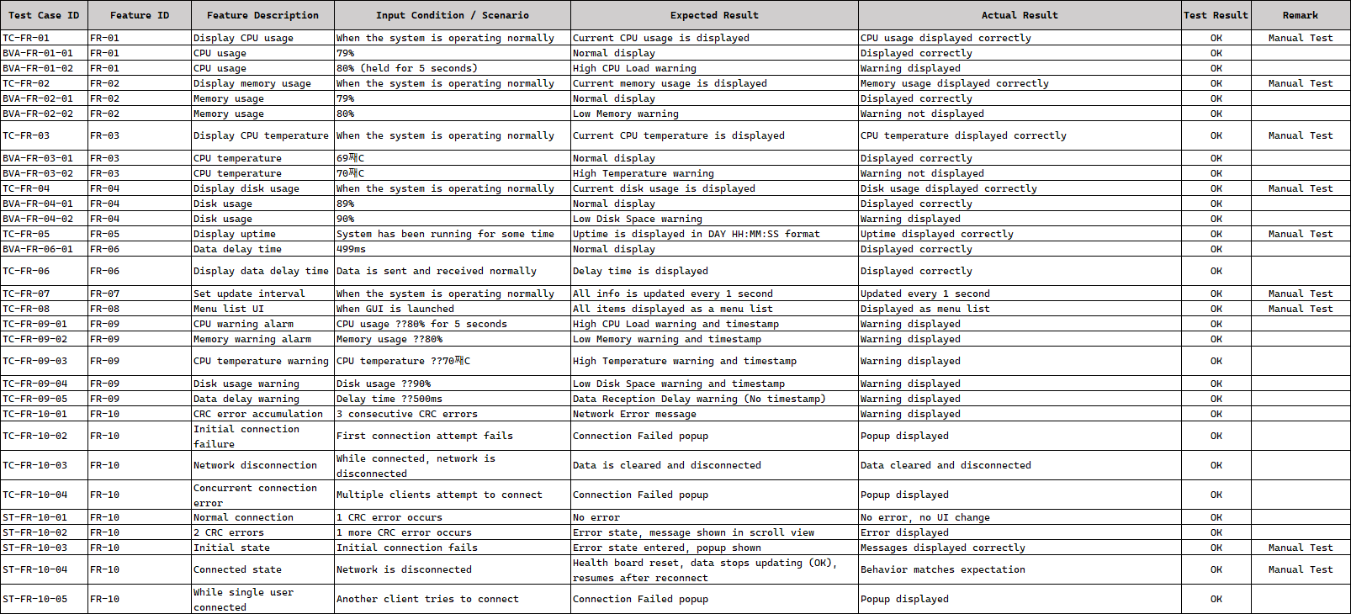
Appendix.Test #3 Result

Slide 28
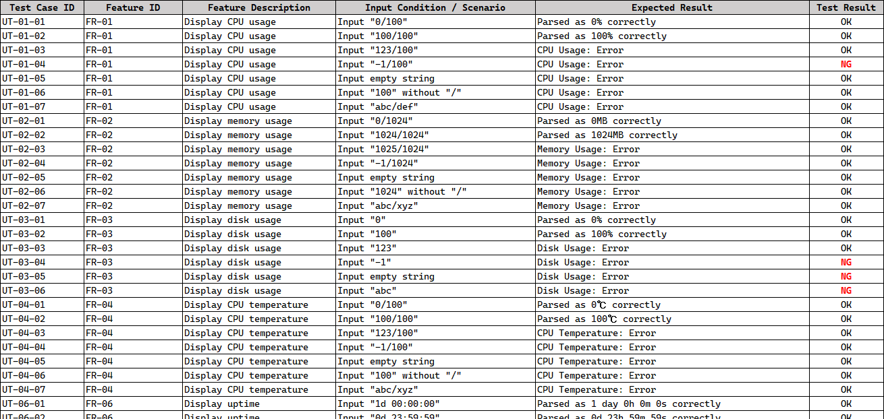
Appendix.Test #4 Result

Slide 29
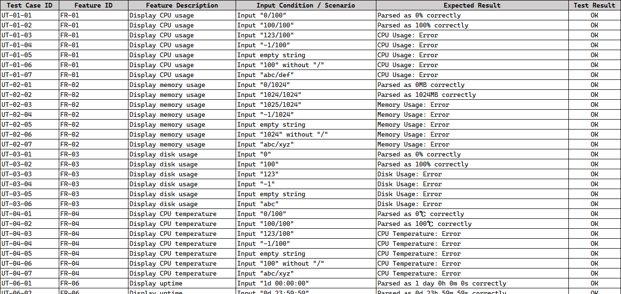
Appendix.Test #5 Result

